Slide 1
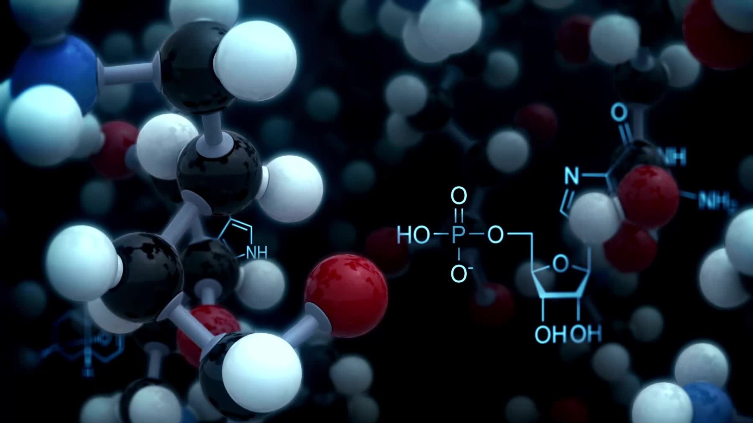
AI in Predictive Toxicology: Enhancing Drug Safety
Predicting Drug Toxicity Early in Drug Development

Slide 2
Group Members
Andres C0931978
Johan C0931102
Amandeep C0937432
Amita C0935607
Manjot C0938094
Anju C0935847
Sarita C0938516
Brian C0940439

Slide 3
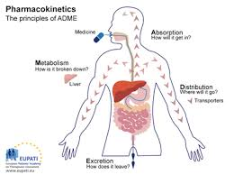
Introduction to Drug Toxicity
Drug toxicity refers to harmful effects a drug can cause in the body.
Can lead to organ damage, severe side effects, or even death if not identified early.
Diagram showing the effects of drug toxicity on organs like liver, kidneys, etc.

Slide 4
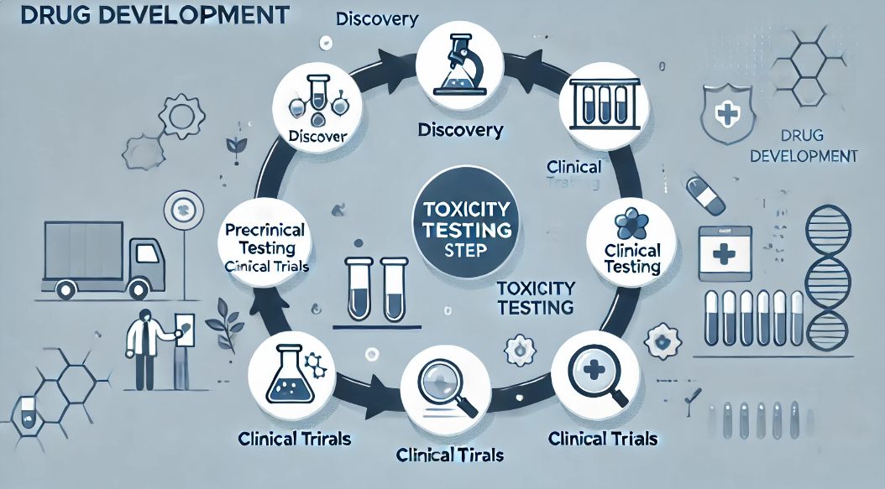
Understanding the drug Development industry and Toxicity Challenges
Drug Development:
The pharmaceutical industry is highly regulated and focuses on discovering, developing, and bringing new drugs to market.
Long, costly process (10+ years, $1-2 billion).
The Role of Toxicity Testing:
Toxicity testing is a critical step in ensuring the safety and efficacy of drugs.
Drug toxicity refers to harmful side effects that can occur, potentially leading to severe health risks for patients.
Our Solution:
Using AI to predict toxicity early, reducing failure rates.

Slide 5
The Problem: Drug Toxicity in Development
Problem Statement:
High Failure Rates Due to Toxicity: Up to 30% of drugs fail in clinical trials because of unforeseen toxic effects.
Cost and Time Impact: Each failure can lead to significant delays and millions in additional costs.
Why It Matters:
For Pharmaceutical Companies:
Reducing trial failures could save billions and accelerate time to market.
Early toxicity detection lowers risks and increases ROI.
For Patients:
Safer drugs delivered faster.
Reduced exposure to potentially harmful drugs in early trials.

Slide 6

Opportunity:
Using AI to Predict Toxicity Early in the drug development process, reducing late-stage failures and improving success rates.
Target Audience:
Pharmaceutical researchers, drug developers, healthcare organizations.

Slide 7

Why Our AI Solution Stands Out
Current Solutions:
Animal Testing: Expensive, time-consuming, and raises ethical concerns.
Chemical Assays: Limited accuracy, unable to predict complex toxicity.
Our Solution:
AI-Driven Predictions: Faster and more accurate toxicity identification.
Cost-Effective: Reduces dependency on costly lab tests.
Ethical: Minimizes the need for animal testing.

Slide 8

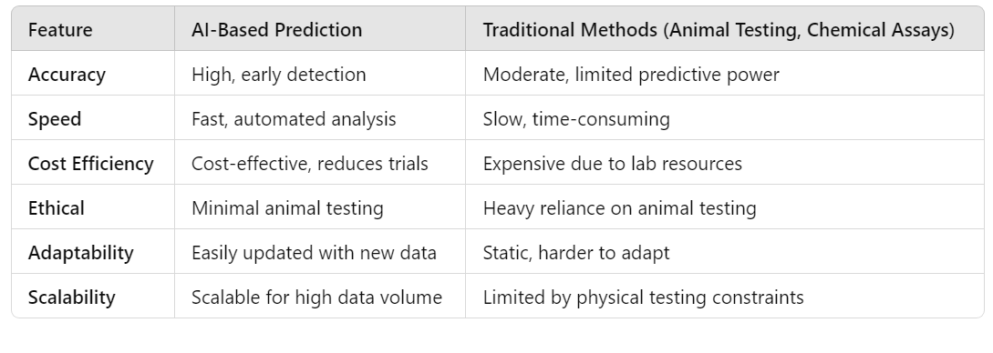

Why Choose Our Solution?

Slide 9
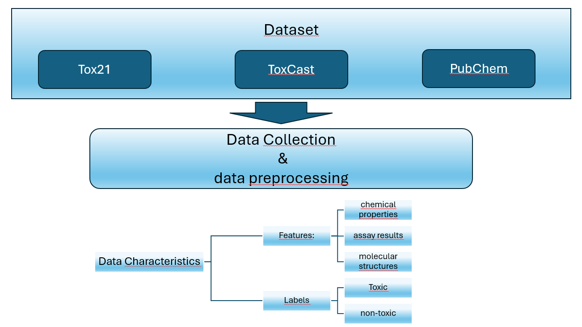
Data Gathering Plan

Slide 10
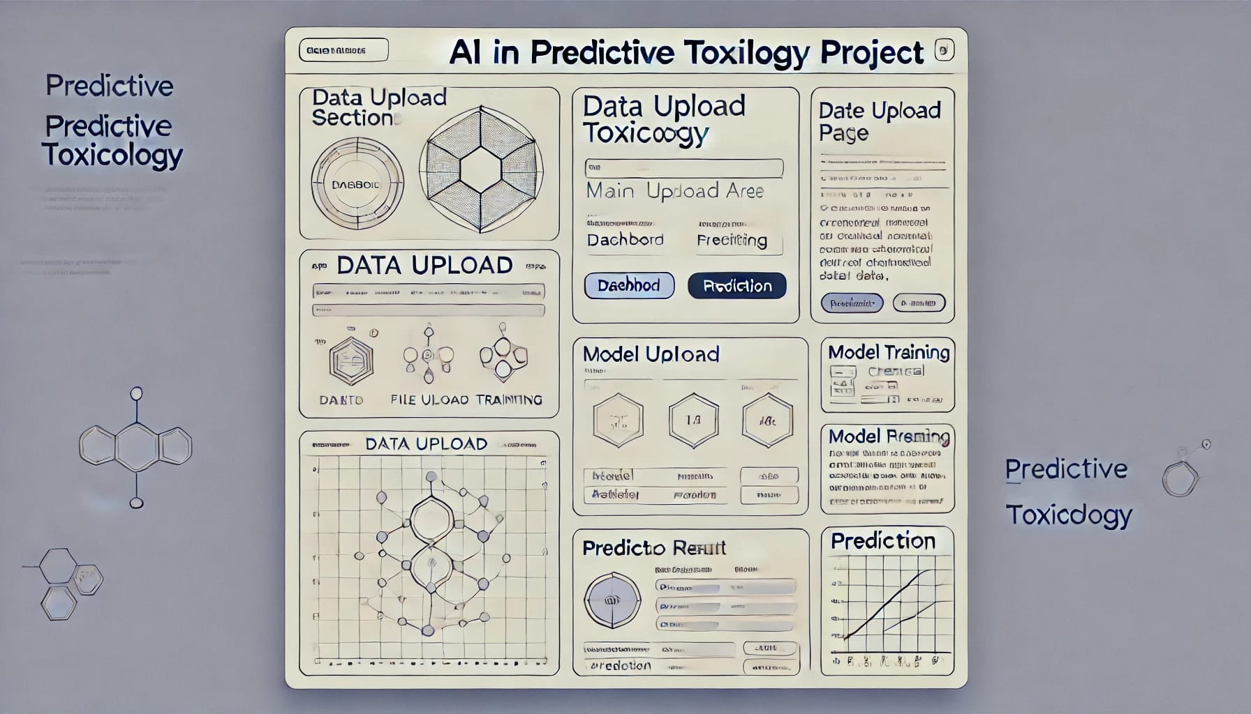
Wireframe

Slide 11
Merci beaucoup

